Slide 1
CHM 5681
IR spectroscopy
Source
Detector
hν
Sample

Slide 2
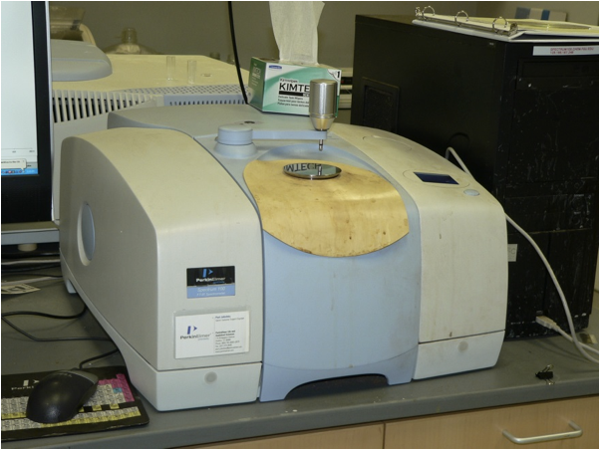
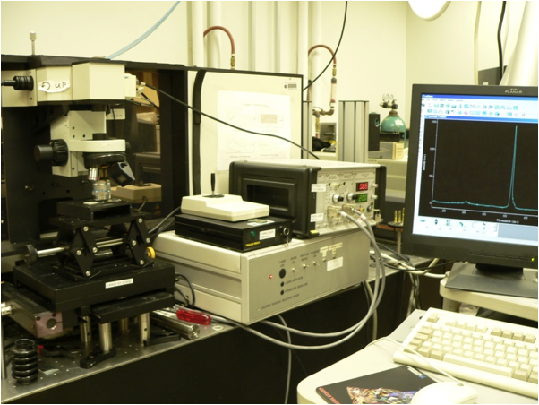
Vibrational Spectroscopy
Infrared Spectroscopy
Raman Spectroscopy

Slide 3
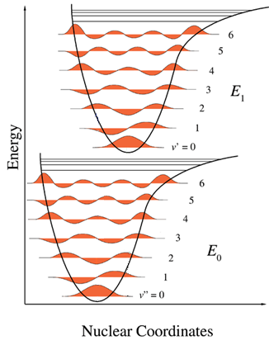
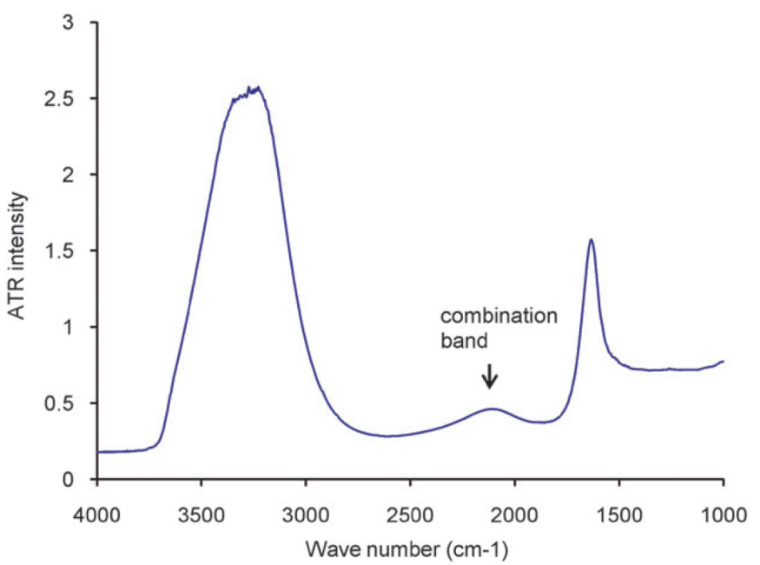
Spectroscopy
Visible: 300-700 nm / 30,000-14,000 cm⁻¹
Mid-IR: 2,500-15,000 nm / 4,000-650 cm⁻¹
Mojet et al. Chem. Soc. Rev. 2010, ASAP.

Slide 4
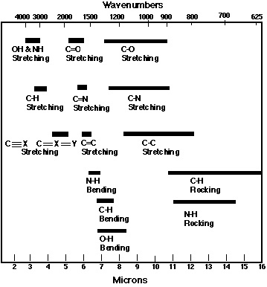
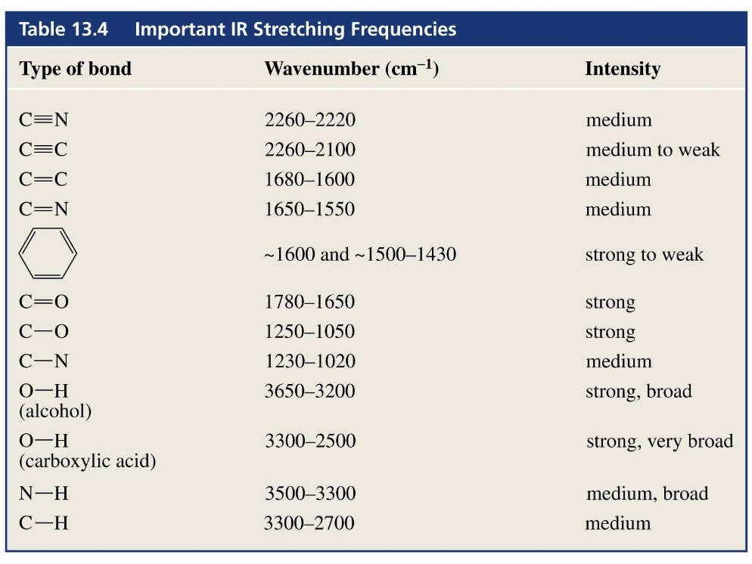
IR Spectroscopy According to Org Chem

Slide 5
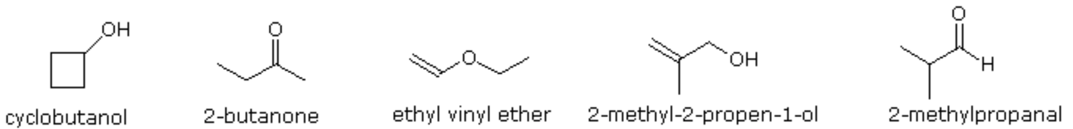
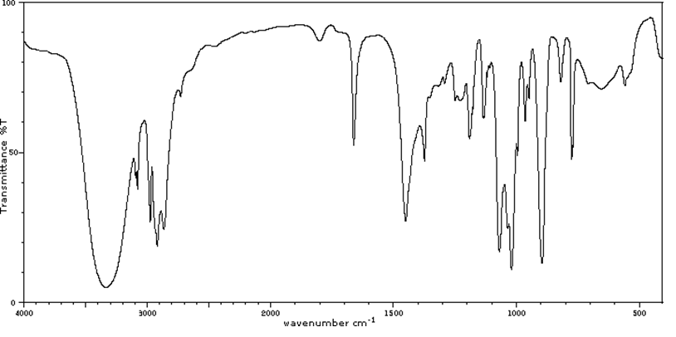
IR Spectroscopy According to Org Chem

Slide 6
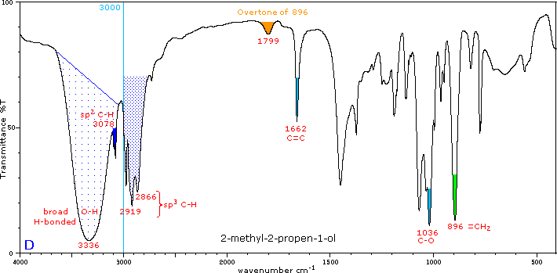
IR Spectroscopy According to Org Chem

Slide 7
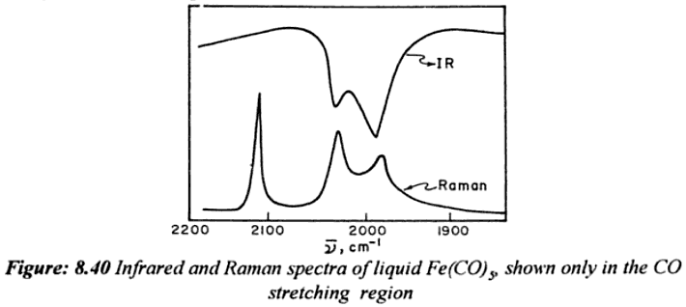
Real IR Spectroscopy
Given the following Raman and IR spectra of Fe(CO)₅ and your character tables, is the molecule square pyramidal or trigonal bipyramidal?
or
Symmetry of Spectroscopy of Molecules by K. Veera Reddy

Slide 8
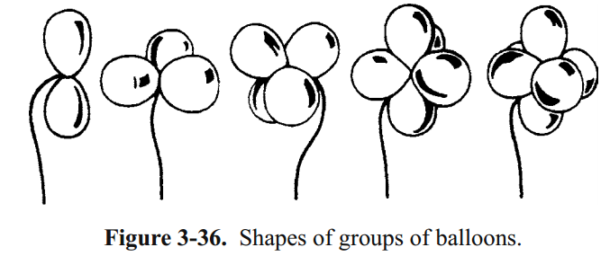

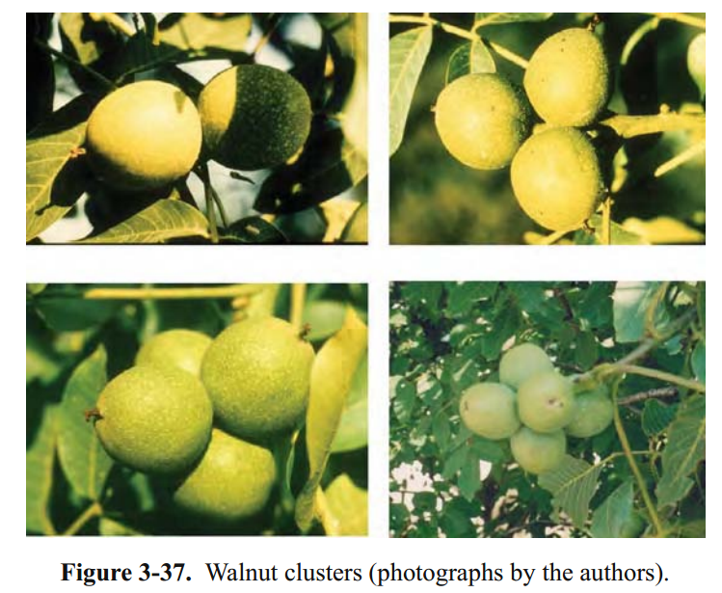
Real IR Spectroscopy
balloon animals + 200 year old math = structure of Fe(CO)₅
or
Irreducible Representation
= 2A₁’ + E’ + A₂”
IR active = E’ + A₂” = 2 peaks
Raman active = 2A₁’ + E’ = 3 peaks

Slide 9
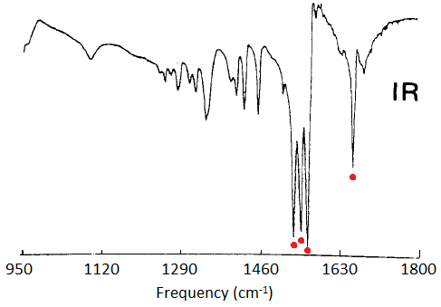
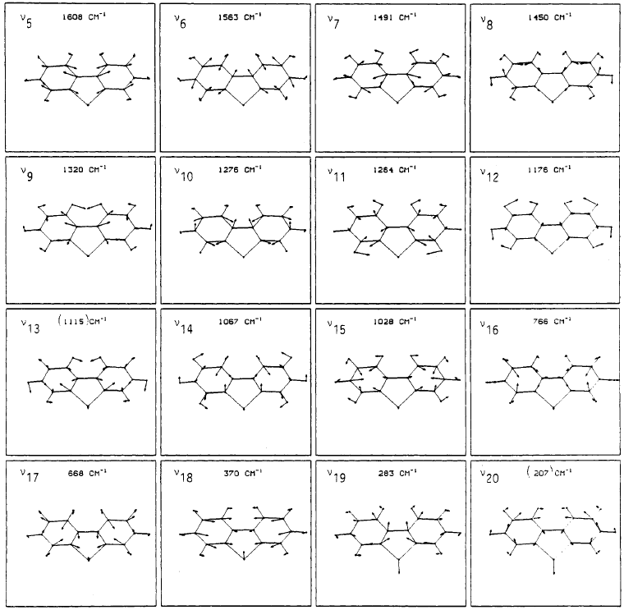
Infrared Spectroscopy
C_{2v}: 20A₁ + 19B₂ + 9B₁
Kincaid et al. J . Phys. Chem. 1988, 92, 5628.

Slide 10
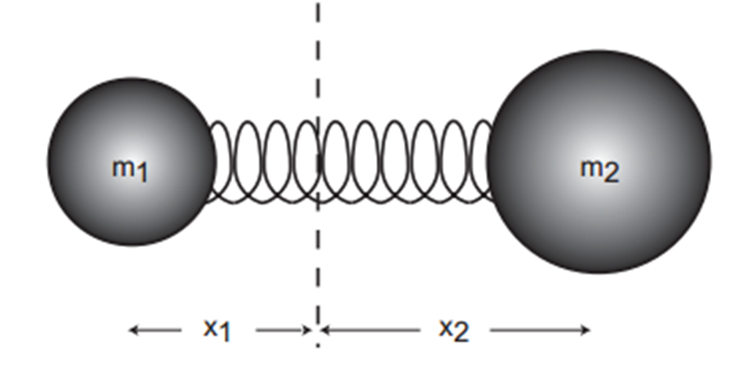
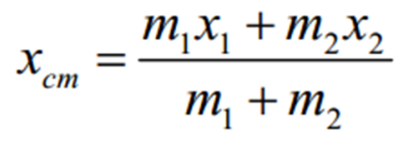
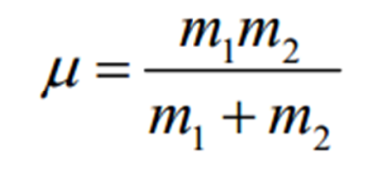
Molecular Vibrations
Atoms of a molecule changing their relative positions without changing the position of the molecular center of mass.
Even at Absolute Zero!
In terms of the molecular geometry these vibrations amount to continuously changing bond lengths and bond angles.
Center of Mass
Reduced Mass

Slide 11
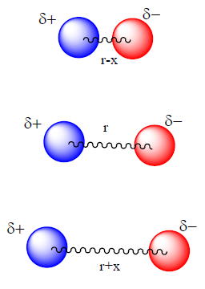
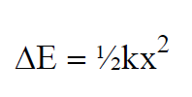
Molecular Vibrations
Hooke’s Law
k = force constant
x = distance
Assumes-
It takes the same energy to stretch the bond as to compress it.
The bond length can be infinite.

Slide 12
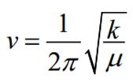
Molecular Vibrations
Vibration Frequency (ν)
Related to:
Stiffness of the bond (k).
Atomic masses (reduced mass, μ).
Visible: 300-700 nm / 30,000-14,000 cm⁻¹
Mid-IR: 2,500-15,000 nm / 4,000-650 cm⁻¹
cm⁻¹ = 10,000,000/nm.
eV = 1240/nm.

Slide 13
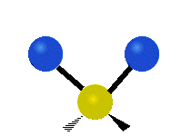
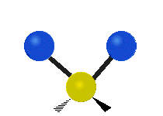



6 Types of Vibrational Motion
Symmetric Stretch
Assymmetric Stretch
Wagging
Twisting
Scissoring
Rocking

Slide 14
The following is a preview for group theory.

Slide 15
Vibrations and Group Theory
What kind of information can be deduced about the internal motion of the molecule from its point-group symmetry?
Each normal mode of vibration forms a basis for an irreducible representation of the point group of the molecule.
1) Find number/symmetry of vibrational modes.
2) Assign the symmetry of known vibrations.
3) Find if a vibrational mode is IR or Raman Active.

Slide 16
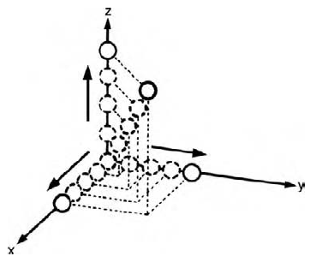
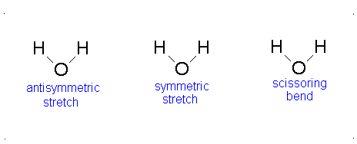
Example: H₂O
3 atoms x 3 DOF = 9 DOF
9 DOF
- 3 Translation
- 3 Rotation
3 Vibration
For a nonlinear Molecule
# of Vibrations = 3N-6

Slide 17
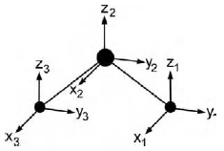
Example: H₂O
Assign a point group
Choose basis function
Apply operations
-if the basis stays the same = +1
-if the basis is reversed = -1
-if it is a more complicated change = 0
C_{2v} point group
Basis: x₁₋₃, y₁₋₃ and z₁₋₃
Atom 1: x₁ = 1
y₁ = 1
z₁ = 1
Atom: 1 2 3
E: 3 + 3 + 3 = 9
Atom 2: x₂ = 1
y₂ = 1
z₂ = 1
E
Atom 3: x₃ = 1
y₃ = 1
z₃ = 1

Slide 18
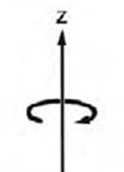
Example: H₂O
Assign a point group
Choose basis function
Apply operations
-if the basis stays the same = +1
-if the basis is reversed = -1
-if it is a more complicated change = 0
C_{2v} point group
Basis: x₁₋₃, y₁₋₃ and z₁₋₃
Atom 1: x₁ = 0
y₁ = 0
z₁ = 0
Atom: 1 2 3
E: 3 + 3 + 3 = 9
Atom 2: x₂ = -1
y₂ = -1
z₂ = 1
C₂: 0 + -1 + 0 = -1
C₂
Atom 3: x₃ = 0
y₃ = 0
z₃ = 0

Slide 19
Example: H₂O
Assign a point group
Choose basis function
Apply operations
-if the basis stays the same = +1
-if the basis is reversed = -1
-if it is a more complicated change = 0
C_{2v} point group
Basis: x₁₋₃, y₁₋₃ and z₁₋₃
Atom 1: x₁ = 0
y₁ = 0
z₁ = 0
Atom: 1 2 3
E: 3 + 3 + 3 = 9
Atom 2: x₂ = 1
y₂ = -1
z₂ = 1
C₂: 0 + -1 + 0 = -1
σ_{xz}
σ_{xz}: 0 + 1 + 0 = 1
Atom 3: x₃ = 0
y₃ = 0
z₃ = 0

Slide 20
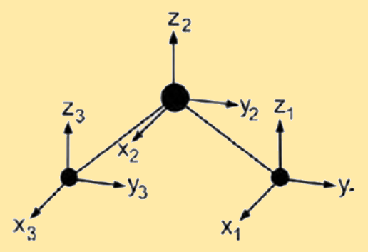
Example: H₂O
Assign a point group
Choose basis function
Apply operations
-if the basis stays the same = +1
-if the basis is reversed = -1
-if it is a more complicated change = 0
C_{2v} point group
Basis: x₁₋₃, y₁₋₃ and z₁₋₃
Atom 1: x₁ = -1
y₁ = 1
z₁ = 1
Atom: 1 2 3
E: 3 + 3 + 3 = 9
Atom 2: x₂ = -1
y₂ = 1
z₂ = 1
C₂: 0 + -1 + 0 = -1
σ_{yz}
σ_{xz}: 0 + 1 + 0 = 1
Atom 3: x₃ = -1
y₃ = 1
z₃ = 1
σ_{yz}: 1 + 1 + 1 = 3

Slide 21

Example: H₂O
Assign a point group
Choose basis function
Apply operations
-if the basis stays the same = +1
-if the basis is reversed = -1
-if it is a more complicated change = 0
Generate a reducible representation
C_{2v} point group
Basis: x₁₋₃, y₁₋₃ and z₁₋₃
Atom: 1 2 3
E: 3 + 3 + 3 = 9
C₂: 0 + -1 + 0 = -1
Γ
9
-1
1
3
σ_{xz}: 0 + 1 + 0 = 1
σ_{yz}: 1 + 1 + 1 = 3

Slide 22
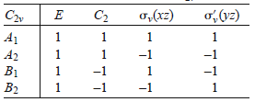
Example: H₂O
Assign a point group
Choose basis function
Apply operations
-if the basis stays the same = +1
-if the basis is reversed = -1
-if it is a more complicated change = 0
Generate a reducible representation
Reduce to Irreducible Representation
C_{2v} point group
Basis: x₁₋₃, y₁₋₃ and z₁₋₃
Γ
9
-1
1
3
Reducible Rep.
Irreducible Rep.

Slide 23
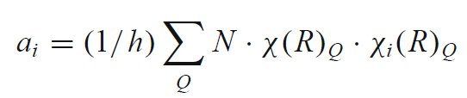
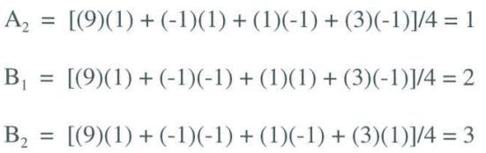
Example: H₂O
Decomposition/Reduction Formula
order (h)
h = 1 + 1 + 1 + 1 = 4
Γ
9
-1
1
3
1
[
]
12
a_{A1} =
(1)(9)(1)
+ (1)(-1)(1) + (1)(1)(1) + (1)(3)(1)
=
= 3
4
4
Γ = 3A₁ + A₂ + 2B₁ + 3B₂

Slide 24
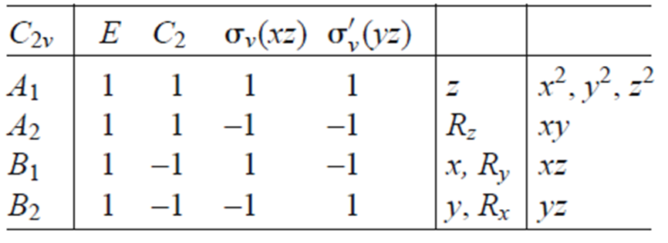
Example: H₂O
Assign a point group
Choose basis function
Apply operations
-if the basis stays the same = +1
-if the basis is reversed = -1
-if it is a more complicated change = 0
Generate a reducible representation
Reduce to Irreducible Representation
Subtract Rot. and Trans.
C_{2v} point group
Basis: x₁₋₃, y₁₋₃ and z₁₋₃
3 atoms x 3 DOF = 9 DOF
3N-6 = 3 Vibrations
Γ = 3A₁ + A₂ + 2B₁ + 3B₂
Trans = A₁ + B₁ + B₂
Rot = A₂ + B₁ + B₂
Vib = 2A₁ + B₂

Slide 25
Example: H₂O
Assign a point group
Choose basis function
Apply operations
-if the basis stays the same = +1
-if the basis is reversed = -1
-if it is a more complicated change = 0
Generate a reducible representation
Reduce to Irreducible Representation
Subtract Rot. and Trans.
C_{2v} point group
Basis: x₁₋₃, y₁₋₃ and z₁₋₃
Vibration = 2A₁ + B₂

Slide 26
Vibrations and Group Theory
1) Find number/symmetry of vibrational modes.
2) Assign the symmetry of known vibrations.
3) Find if a vibrational mode is IR or Raman Active.

Slide 27
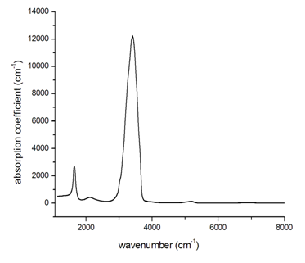
Example: H₂O
Start with a drawing of a molecule
Draw arrows
Use the Character Table
Predict a physically observable phenomenon
C_{2v} point group
Basis: x₁₋₃, y₁₋₃ and z₁₋₃
Vibrations = 2A₁ + B₂
B₂
A₁
All three are IR active but that is not always the case.
A₁

Slide 28
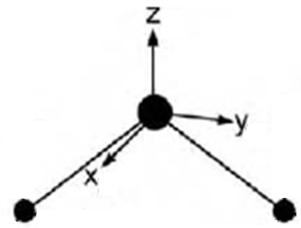
Example: H₂O
Assign a point group
Choose basis function
Apply operations
-if the basis stays the same = +1
-if the basis is reversed = -1
-if it is a more complicated change = 0
C_{2v} point group
Basis: OH stretch
E
E: 2
C₂
C₂: 0
σ_{xz}
σ_{xz}: 0
σ_{yz}
σ_{yz}: 2

Slide 29
Example: H₂O
Assign a point group
Choose basis function
Apply operations
-if the basis stays the same = +1
-if the basis is reversed = -1
-if it is a more complicated change = 0
Generate a reducible representation
Reduce to Irreducible Representation
C_{2v} point group
Basis: OH stretch
Γ
2
0
0
2
Reducible Rep.
Irreducible Rep.

Slide 30
Example: H₂O
Decomposition/Reduction Formula
order (h)
h = 1 + 1 + 1 + 1 = 4
Γ
2
0
0
2
1
[
]
4
a_{A1} =
(1)(2)(1)
+ (1)(0)(1) + (1)(0)(1) + (1)(2)(1)
=
= 1
4
4
1
[
]
4
(1)(2)(1)
+ (1)(0)(-1) + (1)(0)(-1) + (1)(2)(1)
= 1
a_{B2} =
=
4
4
Γ = A₁ + B₂

Slide 31
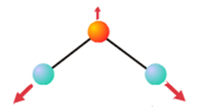

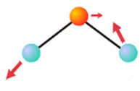
Example: H₂O
2) Assign the Symmetry of a Known Vibrations
Stretch
Stretch
Bend
A₁
Vibrations = A₁ + B₂
B₂
A₁
All three are IR active but that is not always the case.
A₁

Slide 32
Vibrations and Group Theory
1) Find number/symmetry of vibrational modes.
2) Assign the symmetry of known vibrations.
3) Find if a vibrational mode is IR or Raman Active.

Slide 33
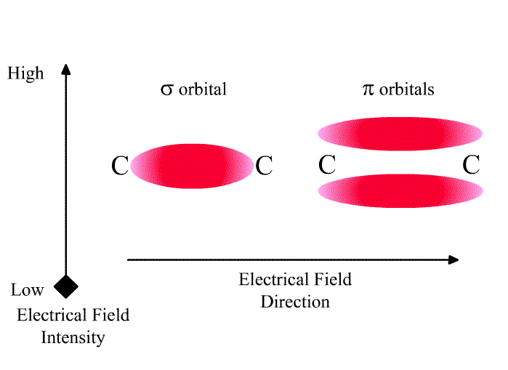

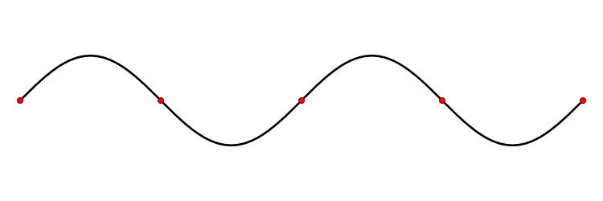
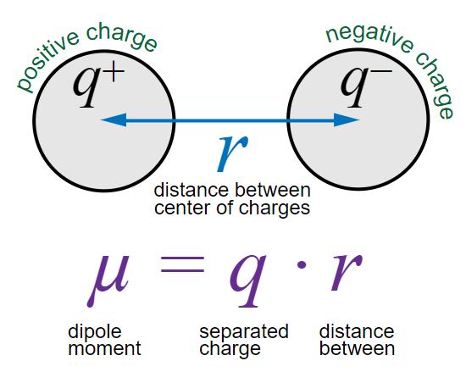
Selection Rules
IR Active
Raman Active
Change in dipole moment.
Change of the polarization.
Deformation of an electron cloud.
If the symmetry label of a normal mode corresponds to x, y, or z, then the fundamental transition for this normal mode will be IR active.
If the symmetry label of a normal mode corresponds to products of x, y, or z (such as x² or yz) then the fundamental transition for this normal mode will be Raman active.

Slide 34
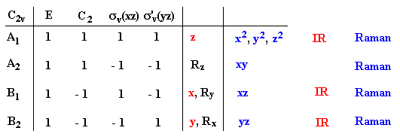
IR vs Raman Active
Stretch
Stretch
Bend
A₁
Vibrations = A₁ + B₂
If the symmetry label of a normal mode corresponds to x, y, or z, then the fundamental transition for this normal mode will be IR active.
If the symmetry label of a normal mode corresponds to products of x, y, or z (such as x² or yz) then the fundamental transition for this normal mode will be Raman active.
A₁ and B₂ are IR and Raman Active.

Slide 35
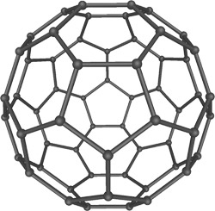
Vibrations of C60
1) Find number/symmetry of vibrational modes.
2) Assign the symmetry of known vibrations.
3) Find if a vibrational mode is IR or Raman Active.

Slide 36
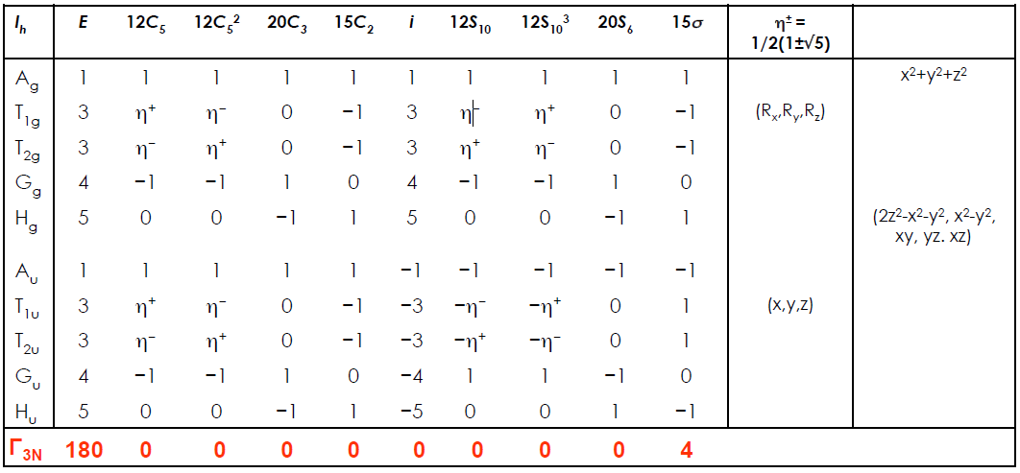
Vibrations of C60

Slide 37
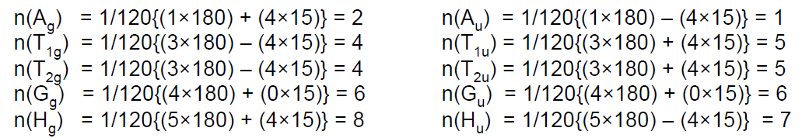
Vibrations of C60

Slide 38
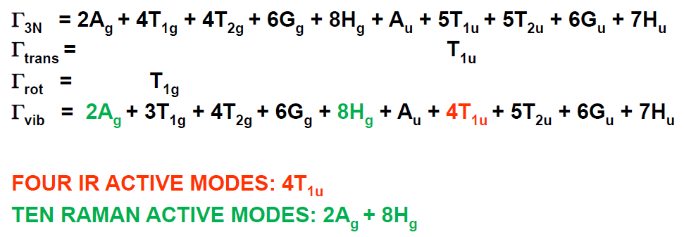
Vibrations of C60

Slide 39
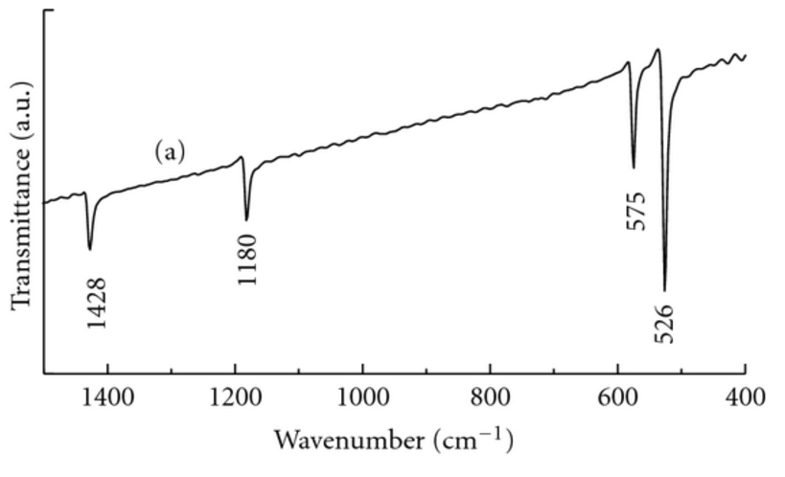
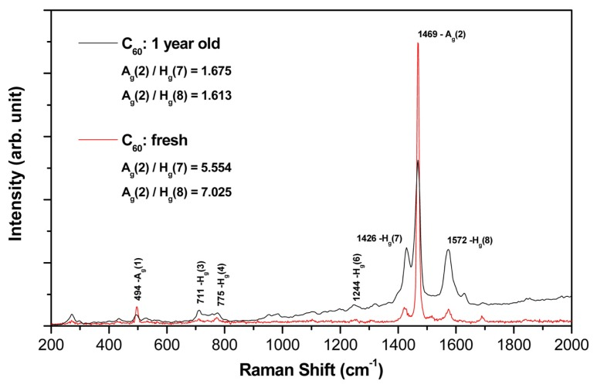
Vibrations of C60
IR
Raman

Slide 40
End of preview.

Slide 41

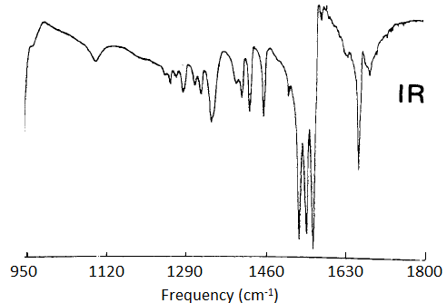
Infrared Spectroscopy
IR Source
Detector
hν
Sample
Procedure
Step 1: Prepare a sample
Step 2: ???
Step 3: Obtain spectra (Profit!)

Slide 42
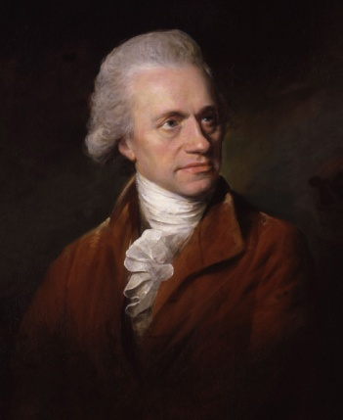
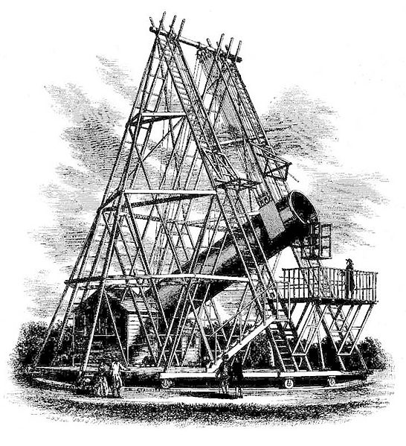
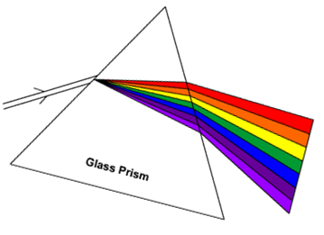

Infrared Spectroscopy
Discovered:
Uranus
Infrared light
(1800)
Friedrich Wilhelm Herschel
Astronomer
Infrared
H₂O
Sun
Thermometers

Slide 43
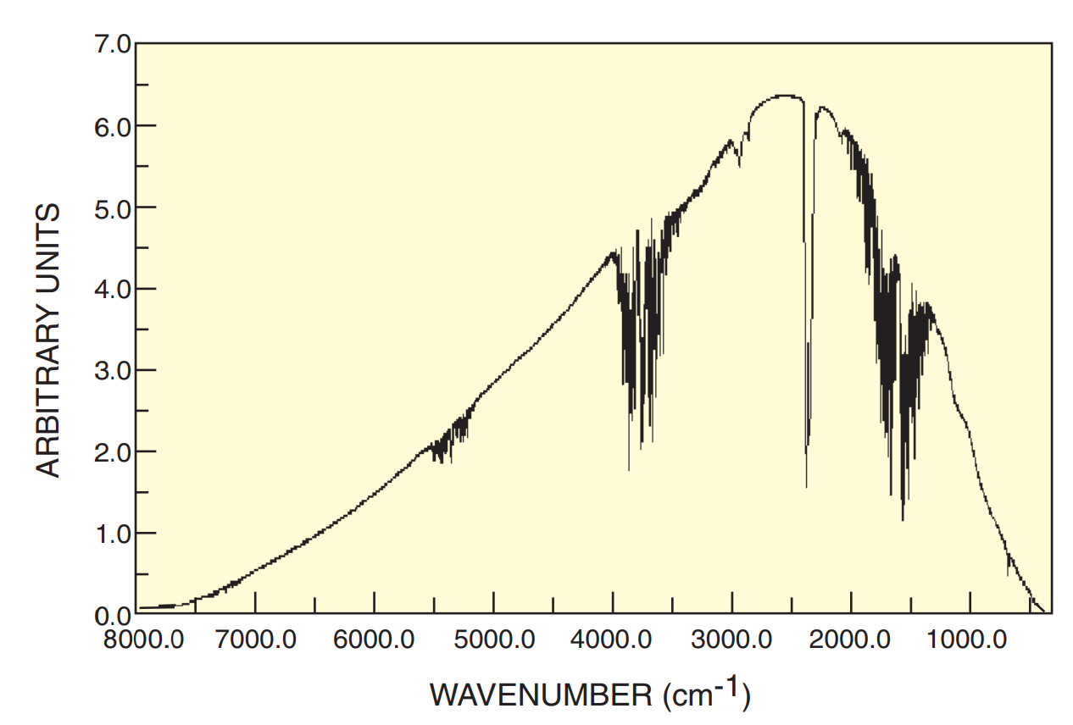

Infrared Sources
IR Source
Detector
hν
Sample
Globar (silicon carbide at 1500 K)

Slide 44


Infrared Detectors
IR Source
Detector
hν
Sample
MCT: HgCdTe
Diode (negative bias)

Slide 45

Infrared Detectors
IR Source
Detector
hν
Sample
DTGS: Deuterated Tri Glycine Sulfate
(ND₂CD₂COOD)₃·D₂SO₄
pyroelectric

Slide 46


Infrared Spectrometers
Dispersive IR Spectrometer
To separate IR light, a grating is used.
Detector
Grating
Slit
Same:
Source
Detector
Sample
Light source
Fixed CCM
An interferogram is first made by the interferometer using IR light.
Difference:
How you obtain wavelength versus intensity data.
Detector
B.S.
Sample
Moving CCM
IR Light source
FT-IR Spectrometer

Slide 47

Dispersive IR Spectrometer
To separate IR light, a grating is used.
Detector
Grating
Slit
Sample
Light source
Detector
Sample
Source
hν

Slide 48
Dispersive IR Spectrometer

Slide 49

Commercial Dispersive IR Spectrometer

Slide 50
FT-IR Spectrometer
SM
Detector
B.S.
Sample
MM
IR Light source
Interferometer: beam enters the interferometer where the “spectral encoding” takes place
Moving mirror in the interferometer is the only moving part of the instrument
Stationary mirror
Beam splitter takes the incoming beam and divides it into two optical beams
Interferogram signal then exits the interferometer
FT: Fourier transform

Slide 51



Michelson–Morley Experiment (1887)
Shine light.
Measure intensity.
Move mirror. Repeat 2.
Graph intensity versus distance.
Turn the interferometer. Repeat.
An attempt to detect the relative motion of matter through the stationary luminiferous aether.
Stationary Mirror
Source
Mobile Mirror
Orientation made no difference.
There was no aether!!
Eye Piece

Slide 52

Interferometer
𝛿=0 or 𝛿= 𝑛𝜆 constructive interference
𝛿=𝜆/2 or 𝛿 = (𝑛 + 1)𝜆/2 destructive interferences

Slide 53

Interferometer

Slide 54





Interferogram
Single λ
Multiple λ
Centreburst
@0: d_{OM} = d_{OS}
Sum

Slide 55
FT-IR Spectrometer
Interferogram of Background (w/o sample)
-Source and detector on
-Move mirror through entire range
Interferogram of Sample
-Source and detector on
-Move mirror through entire range
…Obtain Spectrum
Light
source
Beam splitter
Movable mirror
Sample chamber
Fixed mirror
Detector
Interferometer

Slide 56

FT-IR Spectroscopy
Interferogram
Spectrum
??????

Slide 57


Fourier Transform
Intensity
Time Domain
OPD / cm
Joseph Fourier (1768-1830)
Mathematician + Physicist
“Fourier” Transform
Discovered:
the Green House effect
Frequency Domain
Intensity
Wave number / cm⁻¹

Slide 58
Fourier Transform
IR spectroscopy
X-ray diffraction
Electron microscopy
NMR spectroscopy
Fluorescence spectroscopy
Image processing
Joseph Fourier (1768-1830)
Mathematician + Physicist
“Fourier” Transform
Discovered:
the Green House effect

Slide 59




Fourier Transform
Interferogram
Contributing Waves
=
+
Time Domain
Frequency Domain

Slide 60

Fourier Transform

Slide 61


Fourier Transform
FT

Slide 62






Fourier Transform
FT
FT
Long pass filter
iFT

Slide 63
FT-IR Spectroscopy
Interferogram of Background
-Source and detector on
-Move mirror through entire range
Interferogram of Sample
-Source and detector on
-Move mirror through entire range
FT_{(sample)}/FT_{(background)} = IR spectrum
Light
source
Beam splitter
P / P₀ = %T
Movable mirror
Computer
Sample chamber
Fixed mirror
Detector
Interferometer

Slide 64





FT-IR Spectroscopy
Interferogram
Spectrum
FT
Sample
P
FT
P₀
Background
Distance (MM)
Frequency (cm⁻¹)
P / P₀ x 100=
T(%)
Frequency (cm⁻¹)

Slide 65
FT-IR Spectroscopy
Reference Laser
Sample
Interferogram
Laser Calibration
Summed
Interferogram

Slide 66



Commercial FT-IR Spectrometer
PerkinElmer
Nicolet
Bruker

Slide 67


Infrared Spectrometers
Dispersive IR Spectrometer
FT-IR Spectrometer
Detector
Fixed CCM
Grating
Slit
Detector
B.S.
Sample
Sample
Moving CCM
Light source
IR Light source
Reference and sample simultaneously
Multiple moving parts
Stray light, 2nd order, emission noise
Low intensity (slit limited)
Slow (grating scan)
Resolution: 0.2 cm⁻¹
S/N instrument limited
λ width limited by grating and length
Reference then sample
Only a single mirror moves
Sample after interferometer (rest is lost in FT)
Higher intensity
Faster
Resolution: 0.001 cm⁻¹
S/N scan number/length limited
λ width limited by source

Slide 68
Infrared Spectroscopy
Fixed CCM
Detector
B.S.
Sample
Moving CCM
IR Light source
Infrared Spectroscopic Techniques
Direct Transmission
Reflection Absorption (RAIRS or IRRAS)
Polarization-Modulated RAIRS
Diffuse Reflectance
Photoacoustic
Attenuated Total Reflectance

Slide 69

Direct Transmission
Sources
Detector
Sample
Bruker 80v

Slide 70



Direct Transmission
IR Source
Diode Detector
hν
Sample
Pros:
Simple
Standard
Inexpensive
Cons:
In KBr
No solvent
No surfaces
Boring?
KBr Pellet

Slide 71
Direct Transmission
IR Source
Diode Detector
hν

Slide 72
Reflection Absorption (RAIRS)
AKA: IRRAS, grazing angle IR
From IR Source
To Detector
Reflective surface
Requirements
Highly Reflective
Metals, glass, semiconductor
Planar
Typically monolayers
Disadvantages
Weak Signal (<2% ΔT)
No solvent
Accessory

Slide 73


Reflection Absorption (RAIRS)
Seagull (Harrick Scientific)
Sample

Slide 74



Polarization Modulation-RAIRS
Reflective surface
S-polarized light phase shifts by 180°
P-polarized light phase shifts by 90°
(at 80° incident angle)
0° shift
90° shift
180° shift
φ = 0
φ = 90°
φ = 180°

Slide 75
Polarization Modulation-RAIRS
p
p
s
s
Reflective surface
S-polarized (180° shift) is destructive
-does not contain information about the interface
P-polarized (90° shift) is non-destructive
-does contain information about the interface

Slide 76
Polarization Modulation-RAIRS
p
P_{(p)}
s
P_{(s)}
Reflective surface
P_{(p)} = solvent + surface
P_{(s)} = solvent
P_{(p)} - P_{(s)} = surface

Slide 77

Polarization Modulation-RAIRS
5
1
3,4
Incident light is polarized
PEM shifts between S and P
Polarized light hits sample
At the surface:
-S-polarized signal is nullified
-P-polarized signal is enhanced
Light hits the detector
P_{(p)} - P_{(s)} = surface spectrum
2

Slide 78

PM-RAIRS vs RAIRS
RAIRS
PM-RAIRS
IR inactive
IR active
ITO
Glass Slide
Paniagua et al. J. Phys. Chem. C 2008, 112, 7809.

Slide 79
Polarization Modulation-RAIRS
Pros:
Can use solvent
Suggests orientation
Sensitive
Cons:
Expensive (>$200,000)
Requires reflective surface
Planar surface
IR inactive
IR active
ITO
Glass Slide

Slide 80

Diffuse Reflectance (DRIFTS)
Factors for Scatter
-Particle Size
50 μm or less
-Refractive Index
-Depth
>1.5 mm

Slide 81


Diffuse Reflectance (DRIFTS)
Ellipsoidal Reflector
Integrating Sphere
Incident light
Sample
Detector

Slide 82



Diffuse Reflectance (DRIFTS)
Pros:
Can measure scattering samples
Accessory
Inexpensive
Cons:
Need a scattering sample
No solvent
Not as sensitive
Pike EasiDiff
Pike AutoDiff

Slide 83

Infrared Spectroscopy
IR Source
Detector
hν
?
Sample
Infrared Spectroscopic Techniques
Direct Transmission
Reflection Absorption (RAIRS or IRRAS)
Polarization-Modulated RAIRS
Diffuse Reflectance
Photoacoustic
Attenuated Total Reflectance

Slide 84

Photoacoustic IR Spectroscopy
IR Light
Carrier Gas
Detector
Incident light
Absorbed by sample
Optical to thermal energy
Heat wave through sample
Thermal-expansion-driven pressurization in the gas
Wave hits the detector
-Microphone
-piezoelectric transducer
Sample
Thermal Wave

Slide 85

Photoacoustic IR Spectroscopy
Gratzel et al. J. Phys. Chem. B 2003, 107, 8981.
N712
N719
N3

Slide 86

Photoacoustic IR Spectroscopy
Pros:
Neat Solids
Depth Profiling
Cons:
8 cm⁻¹ resolution
No solvent
Specialty Equipment

Slide 87


Attenuated total reflection (ATR-IR)
Evanescent wave

Slide 88


Attenuated total reflection (ATR-IR)
n₂
n₁
 | n₁ | *d_{p} (μm) | pH Range | LWL, cm⁻¹
AMTIR | 2.5 | 1.46 | 1-9 | 625
Diamond/ZnSe | 2.4 | 1.66 | 1-14 | 525
Diamond/KRS-5 | 2.4 | 1.66 | 1-14 | 250
Germanium | 4 | 0.65 | 1-14 | 780
KRS-5 | 2.37 | 1.73 | 5-8 | 250
Silicon | 3.4 | 0.84 | 1-12 | 1500
Silicon/ZnSe | 3.4 | 0.84 | 1-12 | 525
ZnS | 2.2 | 2.35 | 5-9 | 850
ZnSe | 2.4 | 1.66 | 5-9 | 525
Wavelength
Penetration depth
*d_{p} based on n₂ = 1.5, Θ = 45°, λ = 1000 cm-1
Angle of incidence
Refractive index
crystal (n₁)
sample (n₂)

Slide 89


Attenuated total reflection (ATR-IR)
Single Reflection
Multiple Reflection
Incident light
Detector

Slide 90


Single vs Multi ATR
Pressure
Multi ATR
Sample
vs
Pressure
Sample
Single ATR

Slide 91


Attenuated total reflection (ATR-IR)
Single Reflection
Multiple Reflection

Slide 92

Attenuated total reflection (ATR-IR)
Gratzel et al. J. Phys. Chem. B 2004, 108, 17553.
Z-955
PO₃H₂
SCN
Glass Slide
Glass Slide
Diamond
C-9 alkyl chain- 2856, 2926, 2959 cm⁻¹
Bipyridine- 1398, 1548, 1615 cm⁻¹
PO₃H₂- 952, 1060, 1151 cm⁻¹
SCN- 2104 cm⁻¹
Source
Detector
Single Reflection

Slide 93


Attenuated total reflection (ATR-IR)
sym SO₃
asym SO₃
Concentration
ZnSe Crystal (50 x 10 x 2 mm)
Coat with TiO₂
Molecule + Water (pH 3.5/HCl)
Monitor adsorption vs concentration
Rivera et al. Langmuir 2010, 26, 5534.

Slide 94

Attenuated total reflection (ATR-IR)
Pros:
Solids/powders/solutions
Solid-solution interface
External stimuli
No prep time
Accessory
Monitor kinetics
Cons:
Pressure sensitive
Less resolution
Crystals are expensive

Slide 95


In House FT-IR
PerkinElmer Spectrum 100 FT-IR Spectrometer
Diamond coated ZnSe crystal
Resolution: down to 0.5 cm⁻¹
Range: 400 – 7800 cm⁻¹
ATR and Transmission mode
MAC Lab
(Materials Characterization)
Purchasable Accessories
CSL 116

Slide 96
Infrared Spectroscopy
IR Source
Detector
hν
?
Sample
Infrared Spectroscopic Techniques
Direct Transmission
Reflection Absorption (RAIRS or IRRAS)
Polarization-Modulated RAIRS
Diffuse Reflectance
Photoacoustic
Attenuated Total Reflectance

Slide 97



Time-Resolved Infrared Spectroscopy
Dispersive IR Spectrometer
To separate IR light, a grating is used.
Laser
Detector
Grating
Slit
Sample
Light source
Clock
100 fs - ns
10 ns - seconds

Slide 98


Time-Resolved Infrared Spectroscopy
Dispersive IR Spectrometer
To separate IR light, a grating is used.
Laser
Detector
Grating
Slit
Sample
Light source
Clock
Single Wavelength
Full Spectrum

Slide 99

Time-Resolved Infrared Spectroscopy
FT-IR Spectrometer
Fixed CCM
Can’t monitor λ (cm⁻¹) vs time.
Can’t get a full spectrum at a given time.
Normal FT-IR = 0.1 s resolution.
Detector
B.S.
Sample
Moving CCM
IR Light source
Step-scan FT-IR spectroscopy
Mirror moves in discrete steps
“arrest-and-record” scheme
At each step, the rxn is initiated and the data is collected vs time
Temporal resolution down to 10 ns

Slide 100
Commercial Dispersive
Time-resolved IR Spectrometer

Slide 101

Step-scan FT-IR Spectroscopy
Stop movable mirror
Measure signal vs time

Slide 102


Step-scan FT-IR Spectroscopy
Spectra vs time
Stop movable mirror
Measure signal vs time
Repeat at new mirror position
FT
Compile the intensity at each step at a given time (t_{x})
Create Interferogram at each time
Interferogram vs time

Slide 103

Commercial
Step-Scan FT-IR Spectrometer
Bruker Vertex
“Standard”
FT-IR
Window
Laser

Slide 104



Time-Resolved Infrared Spectroscopy
Organometallics 2008, 27, 5826-5829.

Slide 105


Applications
Identification of inorganic compounds and organic compounds
Identification of components of an unknown mixture
Analysis of solids, liquids, and gasses
Component quantification
Forensic sciences
In measurement and analysis of Atmospheric Spectra
Can also be used on satellites to probe space

Slide 106
IR Spectroscopy End
Any Questions?

